Slide 1
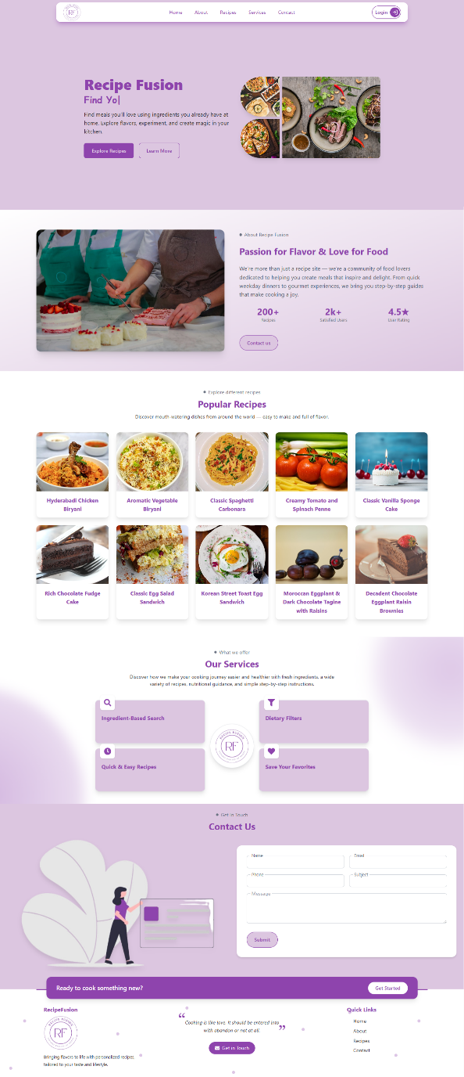
Title: Recipe Fusion – Recipe Generation & Recommendation System
Group Members: Tayyaba Ejaz(2751)
Laiba Hassan(2769)
Project Supervisor: Dr. Sadia Ashraf
Industrial/In House: In House FYP
SDG Goals: Zero Hunger(SDG 2)
Good Health & Well-Being(SDG 3)
Responsible Consumption & Production(SDG 12)
Description: A smart recipe recommendation platform that helps users cook delicious, personalized meals using ingredients they already have. Built on the MERN stack (MongoDB, Express, React, Node.js), the platform intelligently matches your available ingredients and dietary preferences - whether vegan, gluten-free, or whole food plant-based—to curated recipes. It reduces food waste, promotes healthier eating habits, and saves time in meal planning.

